Slide 1

SCSA1401
OBJECT ORIENTED ANALYSIS AND SYSTEM ENGINEERING
BY
Ms. B. KEERTHI SAMHITHA & Ms. SUJA. C. M
Assistant Professor
Department of CSE

Slide 2
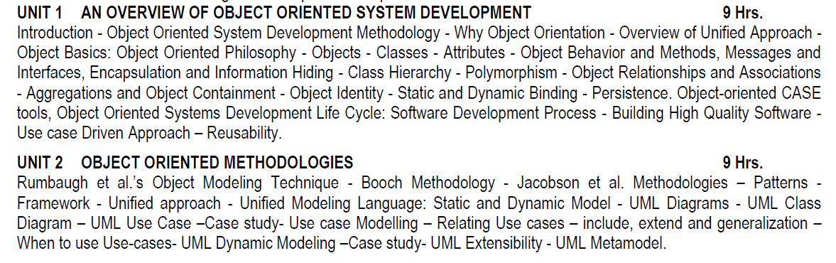
SYLLUBUS

Slide 3
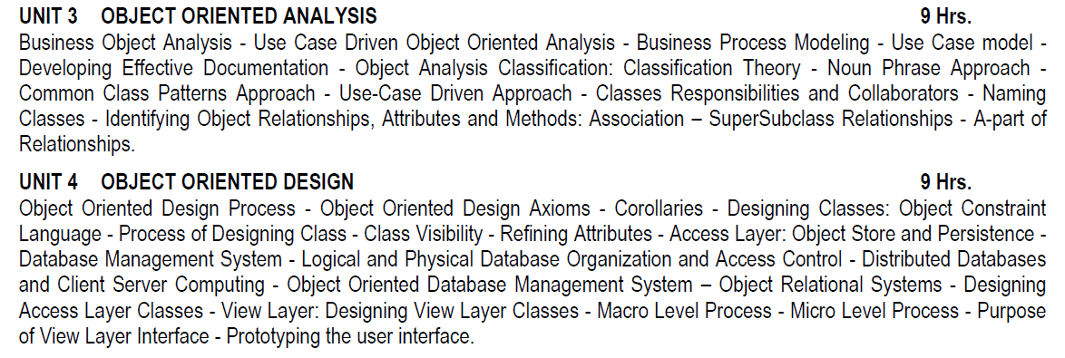
SYLLUBUS

Slide 4
SYLLUBUS

Slide 5
COURSE OUTCOMES
CO | DESCRIPTION
CO 1 | Understand the basics object model for System development.
CO 2 | Understand the object Oriented Methodologies
CO 3 | Express software design with UML diagrams.
CO 4 | Understand the concept of Relationships.
CO 5 | Design software applications using OO concepts
CO 6 | Understand the various testing methodologies for OO software.

Slide 6
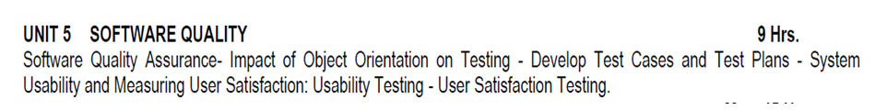
UNIT 5
SOFTWARE QUALITY

Slide 7
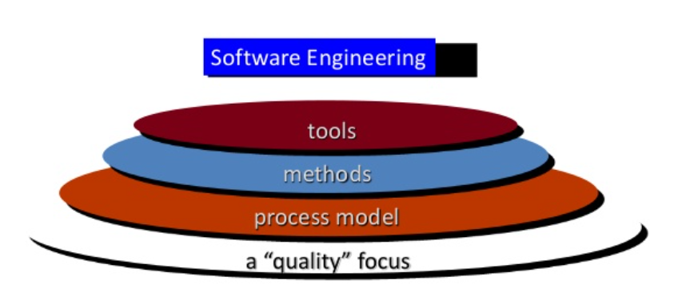
SOFTWARE QUALITY ASSURANCE

Slide 8
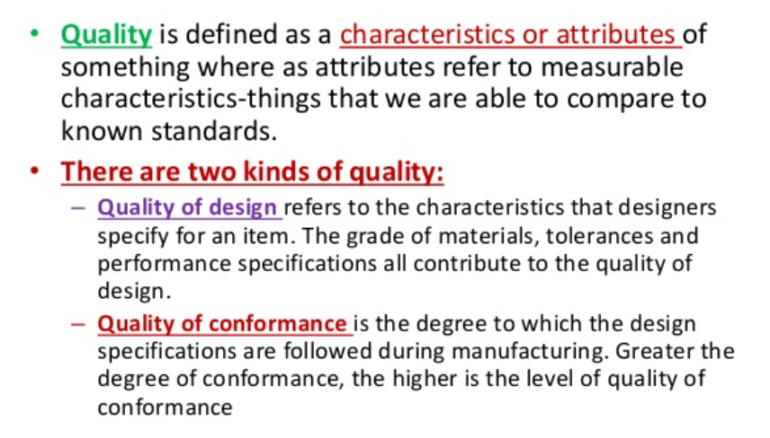
SOFTWARE QUALITY ASSURANCE

Slide 9
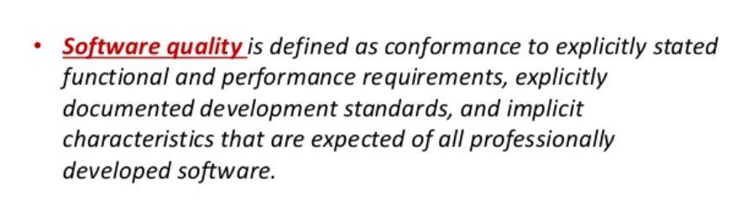
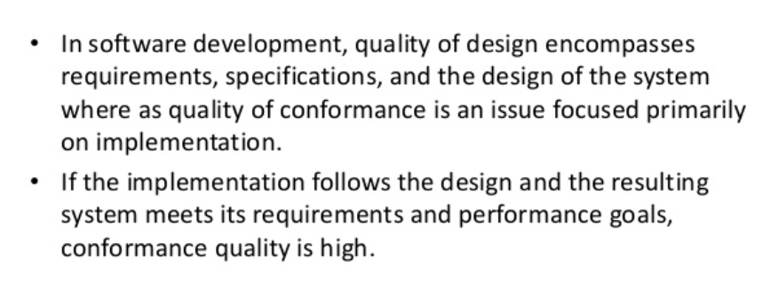
SOFTWARE QUALITY ASSURANCE

Slide 10
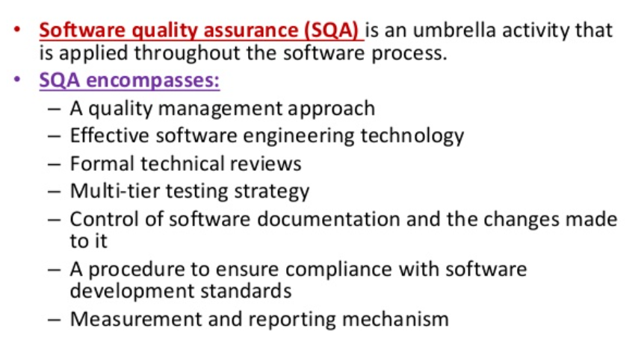
SQA

Slide 11
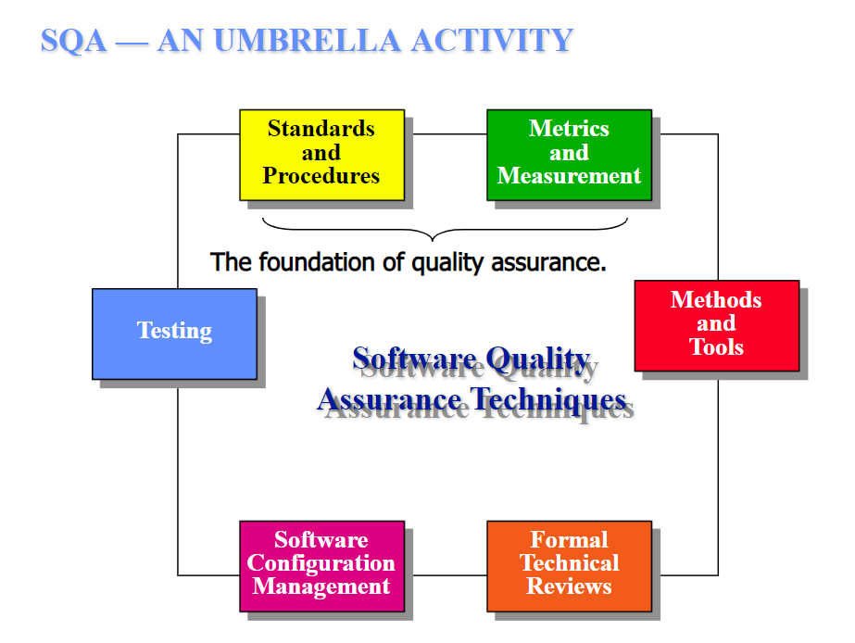

Slide 12
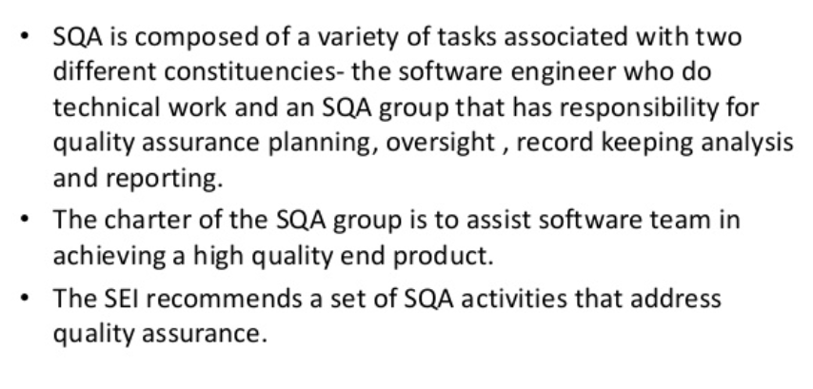
SQA ACTIVITIES

Slide 13
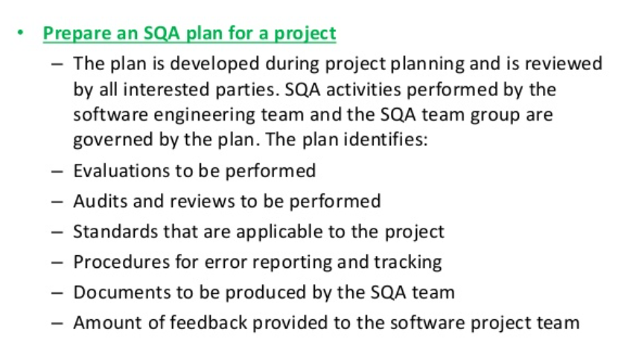
SQA ACTIVITIES

Slide 14
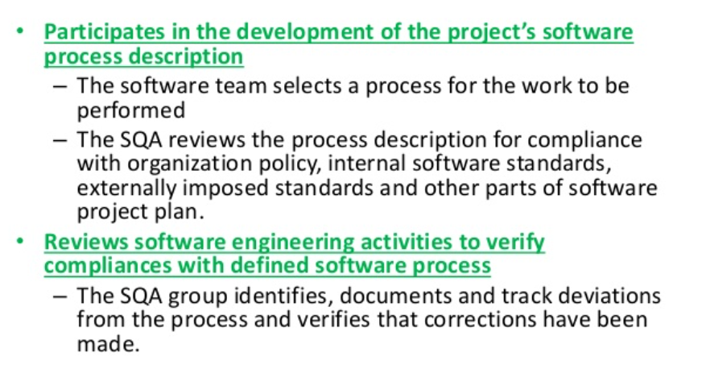
SQA ACTIVITIES

Slide 15
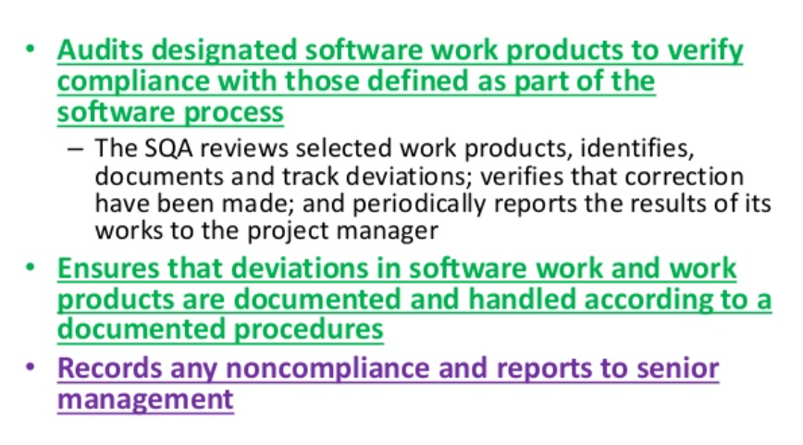
SQA ACTIVITIES

Slide 16
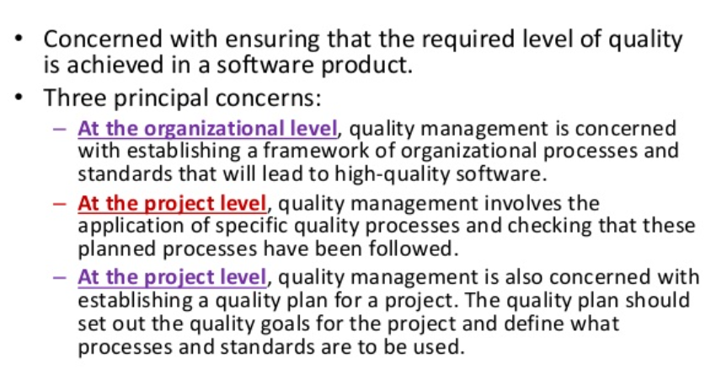
QUALITY CONCEPTS

Slide 17
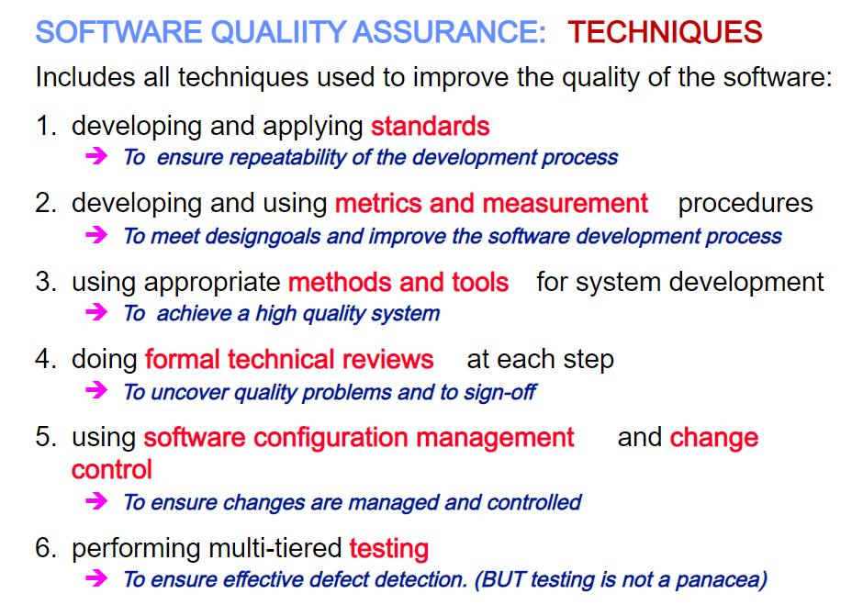
SQA TECHNIQUES

Slide 18
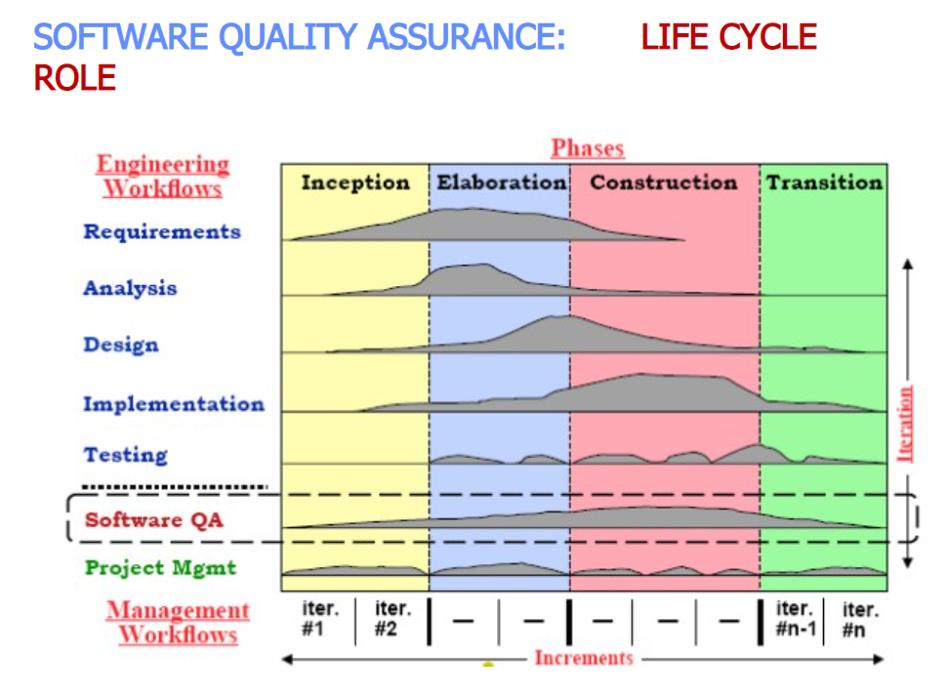

Slide 19
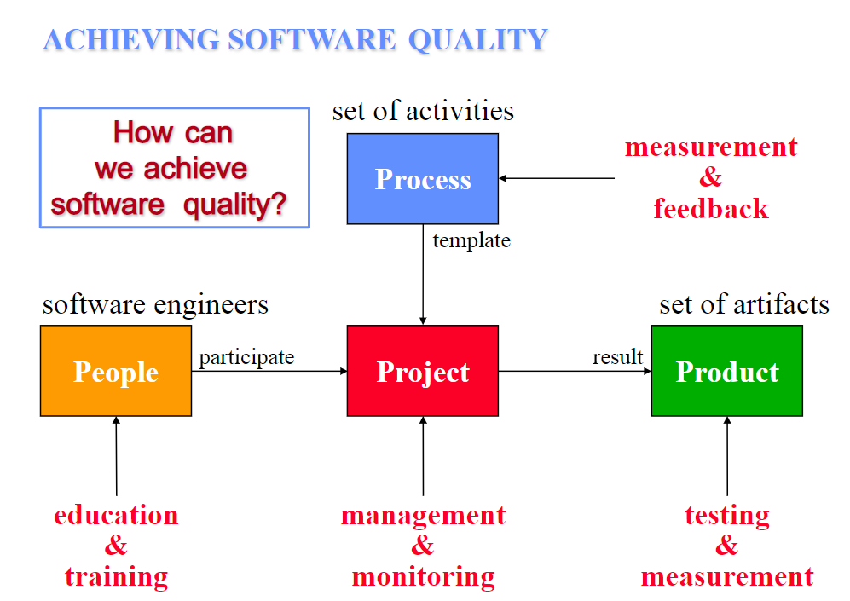

Slide 20
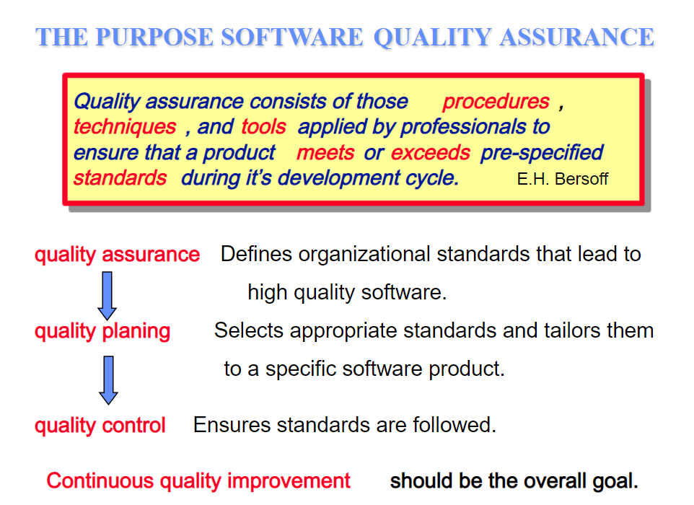

Slide 21
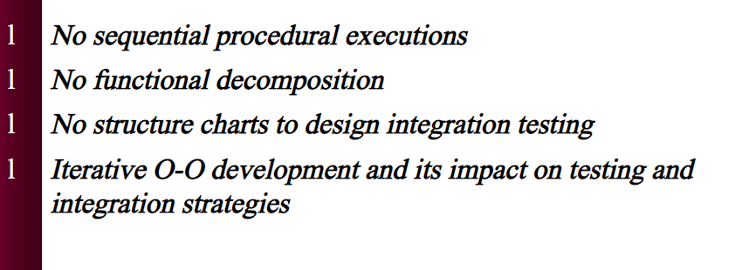
IMPACT OF OBJECT ORIENTATION ON TESTING
TESTING OBJECT ORIENTED APPLICATIONS
WHY IT IS DIFFERENT?

Slide 22
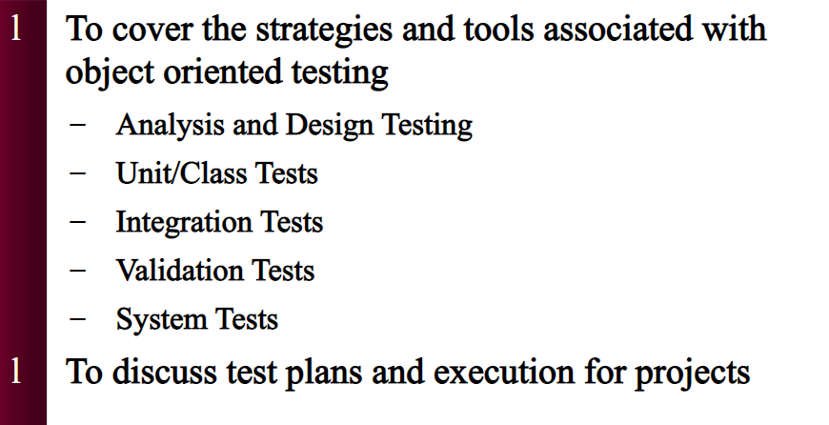
OBJECT ORIENTATION ON TESTING

Slide 23
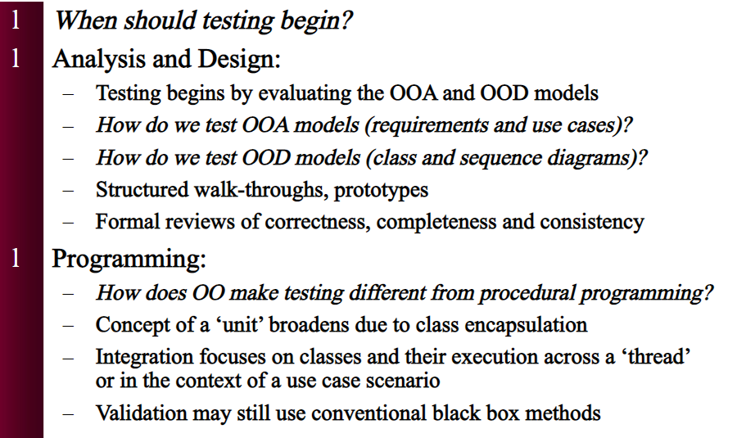
OBJECT ORIENTATION ON TESTING

Slide 24
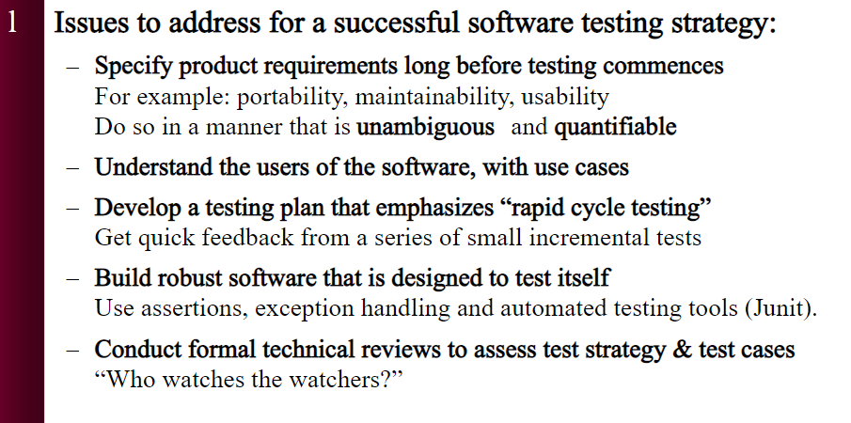
STRATEGIC ISSUES

Slide 25
OO TESTING TECHNIQUES
State model based testing − This encompasses state coverage, state transition coverage, and state transition path coverage.
Use case based testing − Each scenario in each use case is tested.
Class diagram based testing − Each class, derived class, associations, and aggregations are tested.
Sequence diagram based testing − The methods in the messages in the sequence diagrams are tested.

Slide 26
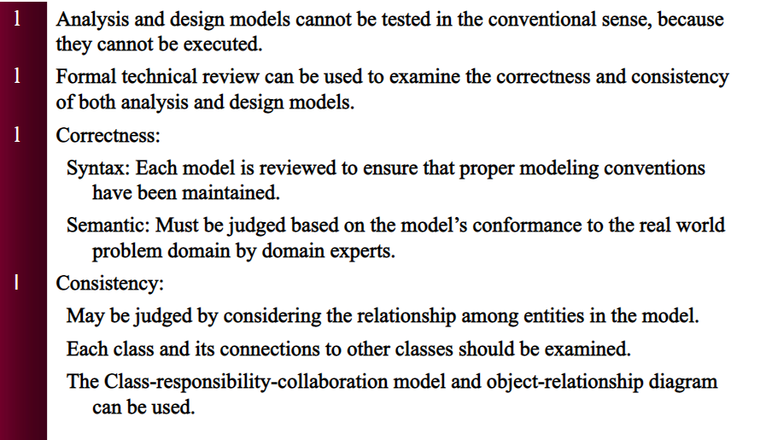
TESTING OOA & OOD MODELS

Slide 27
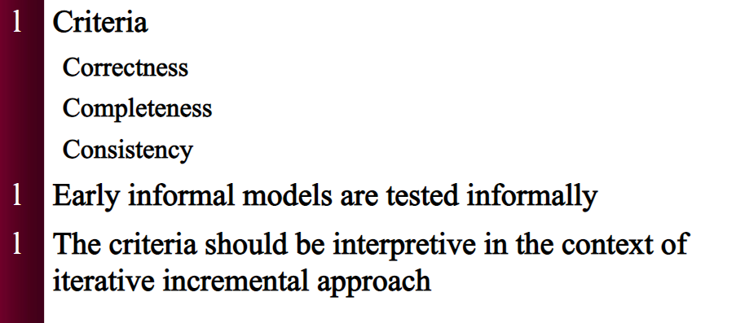
TESTING MODELS

Slide 28
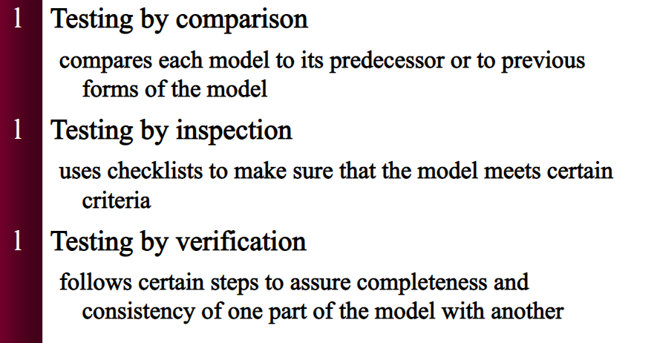
MODEL TESTING APPROACH

Slide 29
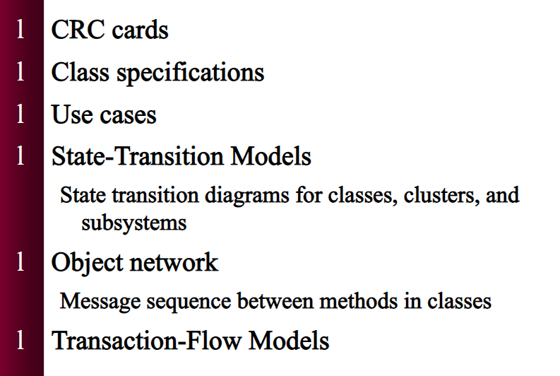
EXAMPLES OF ANALYSIS & DESIGN MODELS

Slide 30
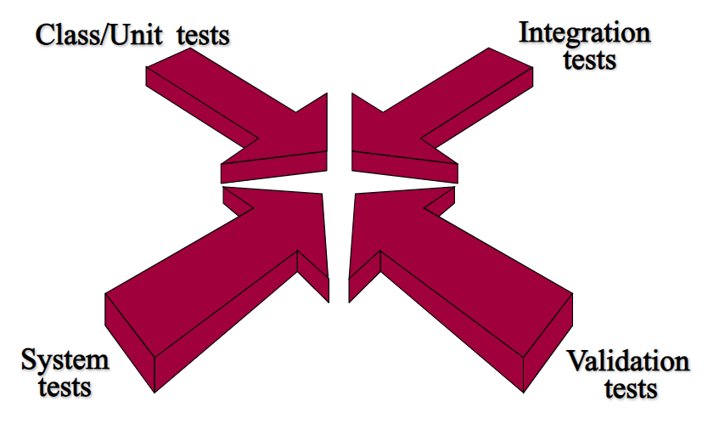
TESTING OO CODE

Slide 31
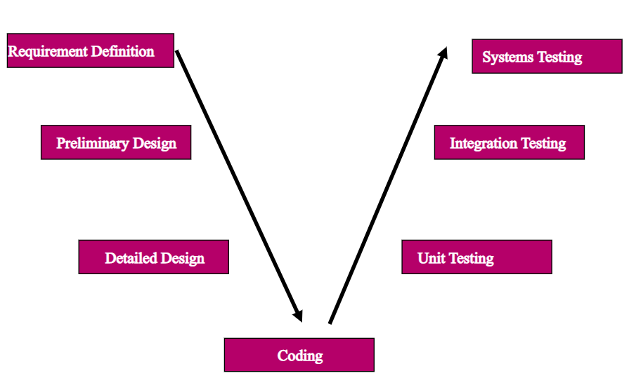
THE STRUCTURED TESTING PYRAMID

Slide 32
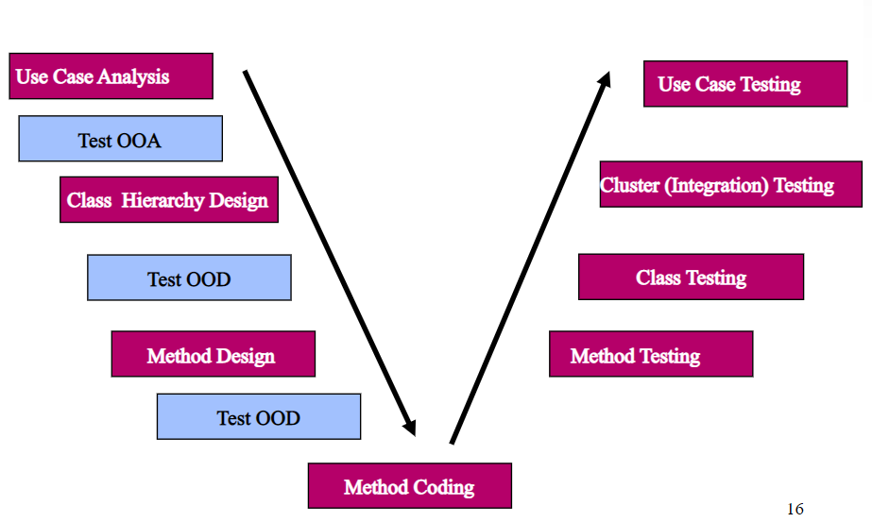
OO TESTING PYRAMID

Slide 33
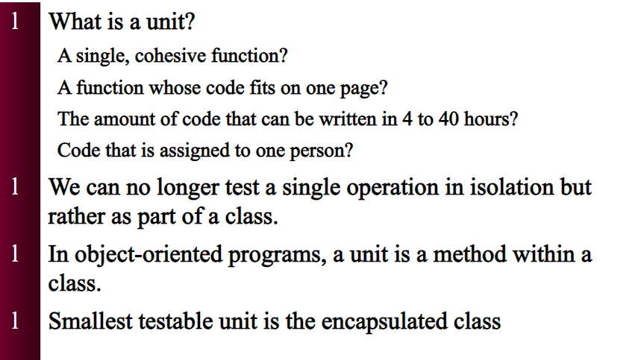
UNIT TEST

Slide 34
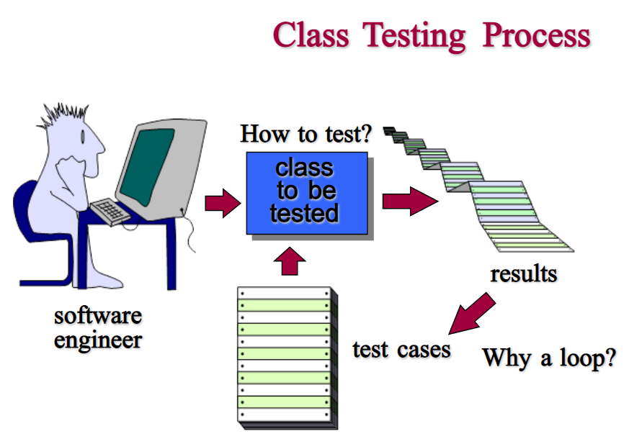

Slide 35
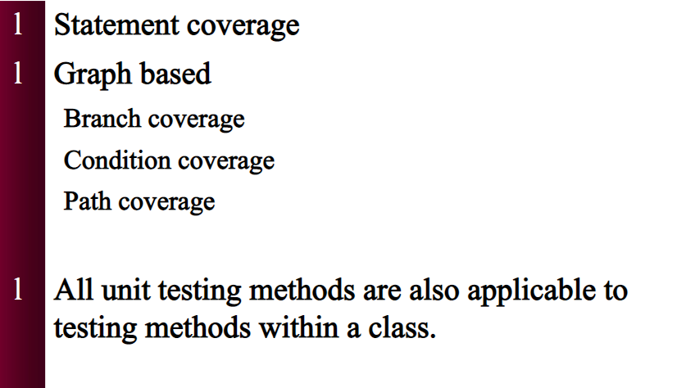
METHODS FOR GENERATING TEST CASES FOR UNIT TESTING

Slide 36
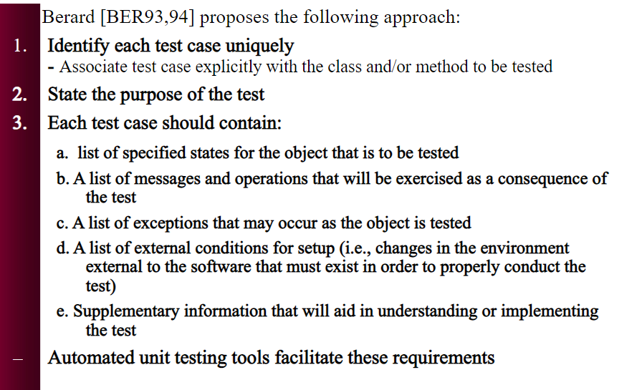
CLASS TEST CASE DESIGN

Slide 37
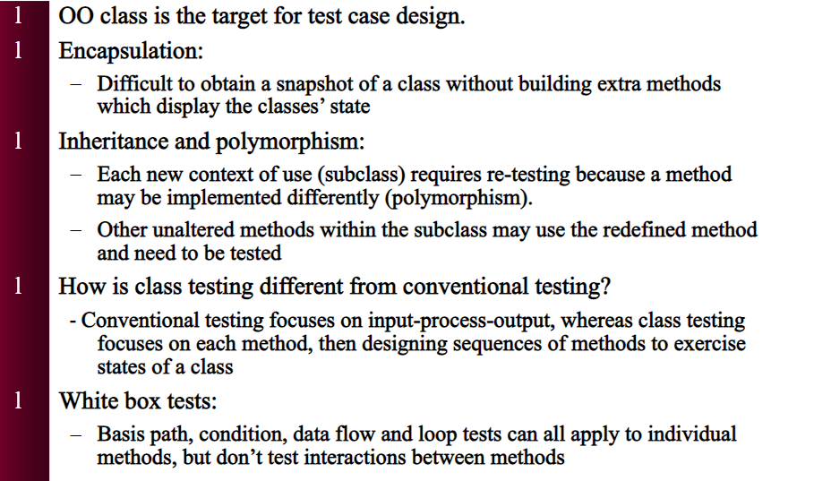
CHALLENGES IN CLASS TESTING

Slide 38
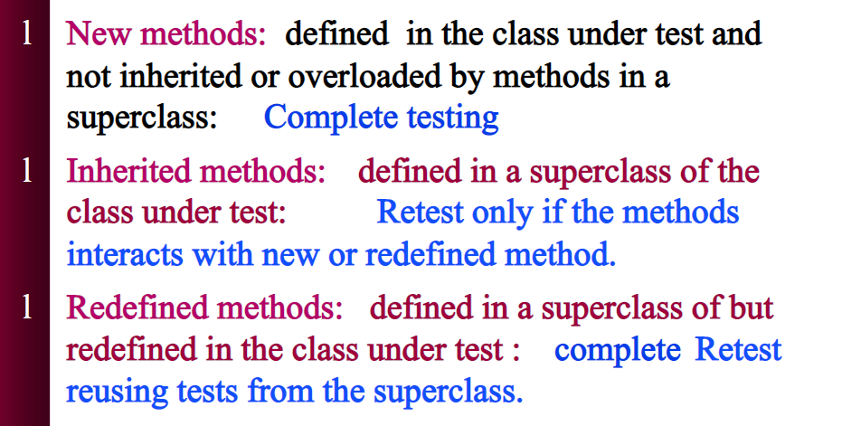
WHAT METHODS TO TEST WITHIN CLASSES

Slide 39
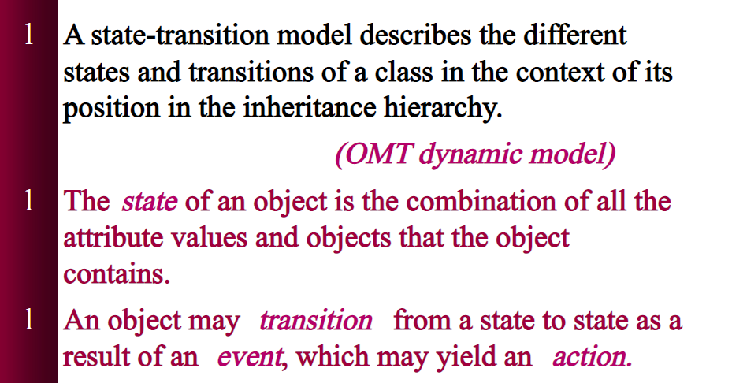
STATE TRANSITION TESTING

Slide 40
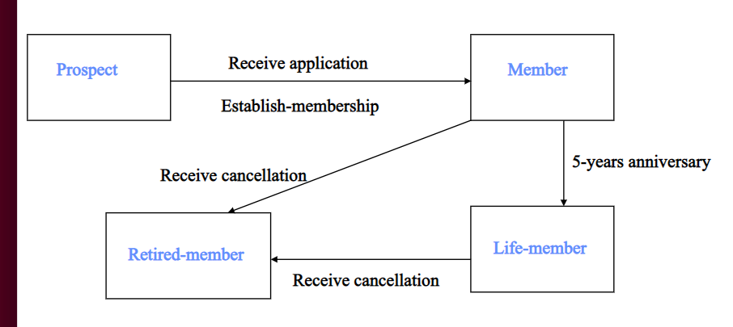
EXAMPLE

Slide 41
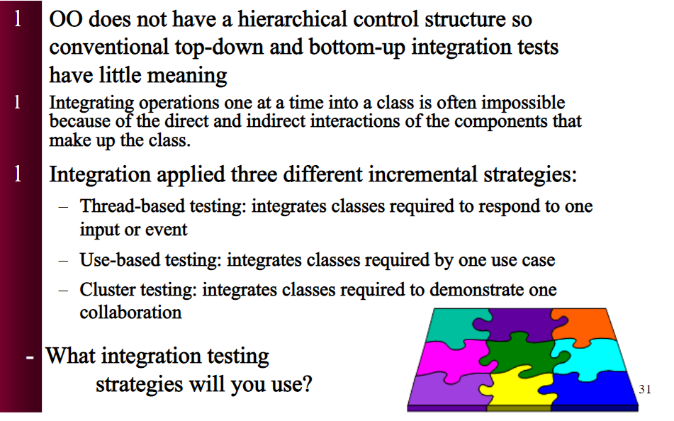
INTEGRATION TESTING

Slide 42
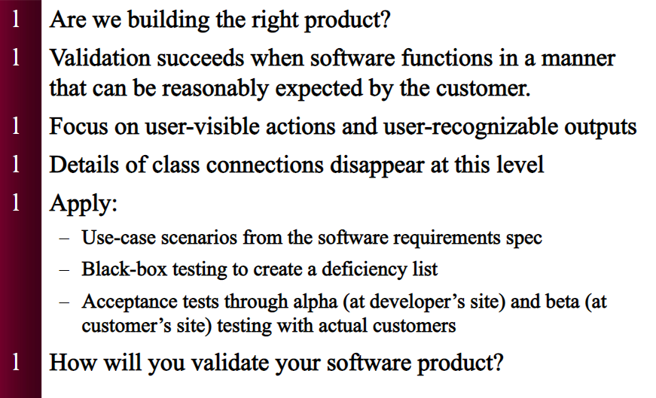
VALIDATION TESTING

Slide 43
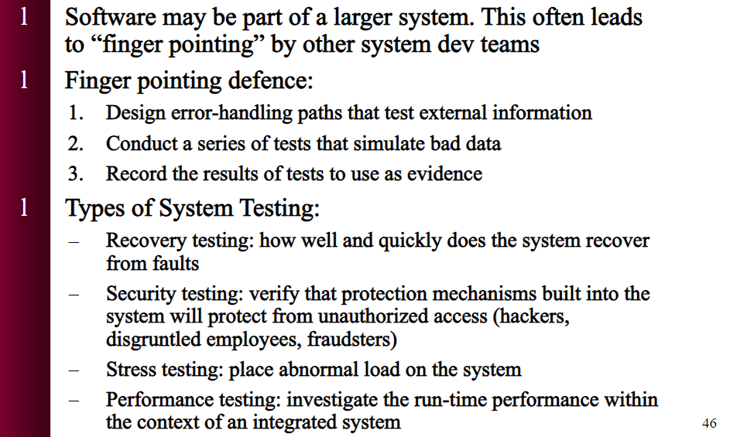
SYSTEM TESTING

Slide 44
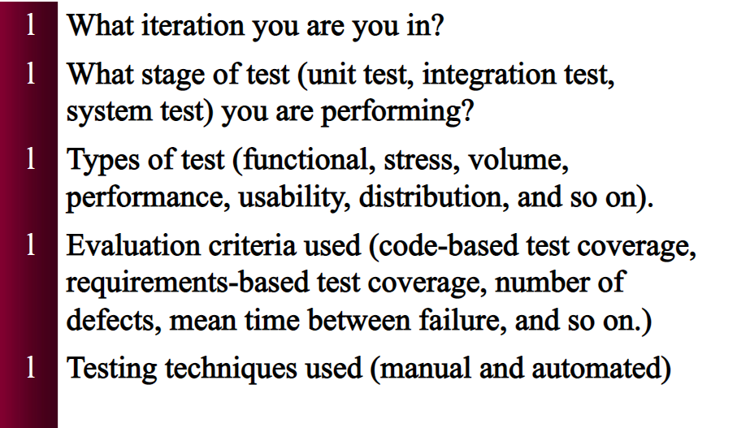
TEST PLANNING

Slide 45
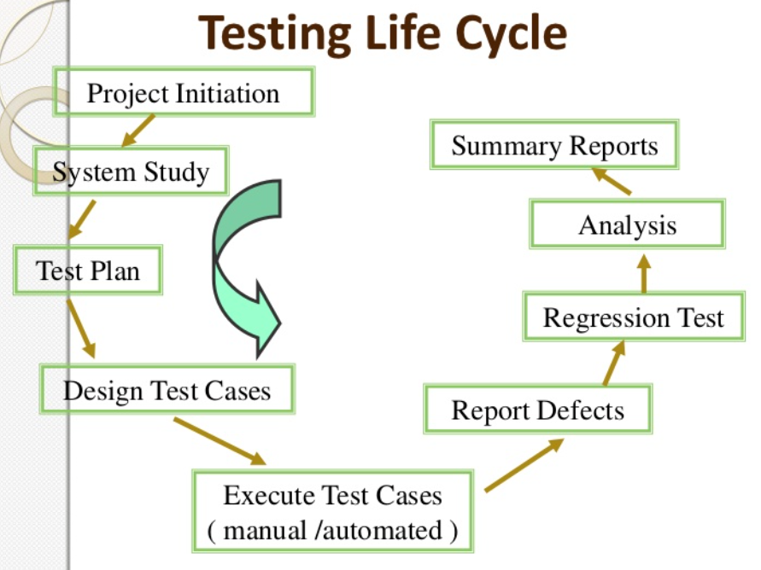

Slide 46
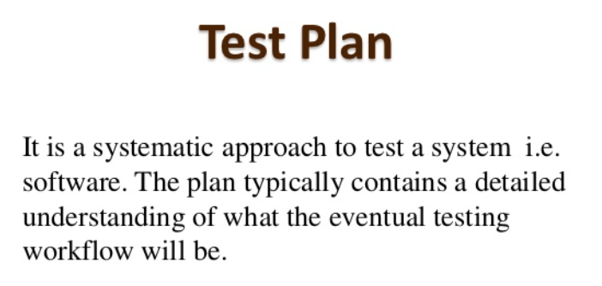
TEST PLAN

Slide 47
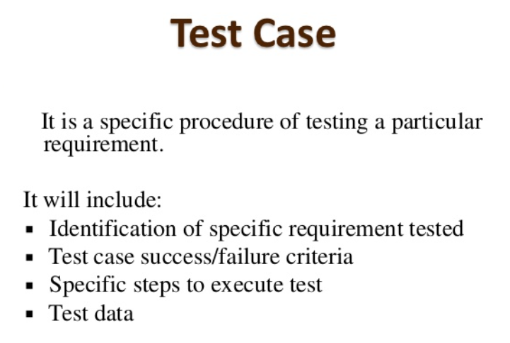
TEST CASES

Slide 48
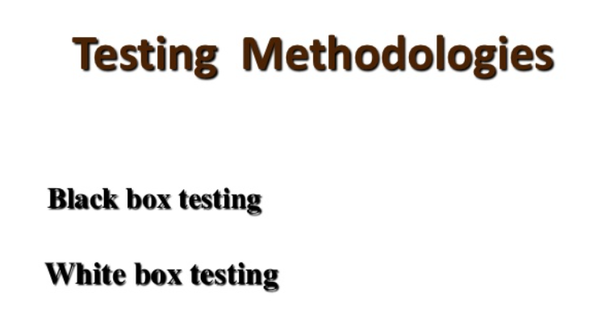
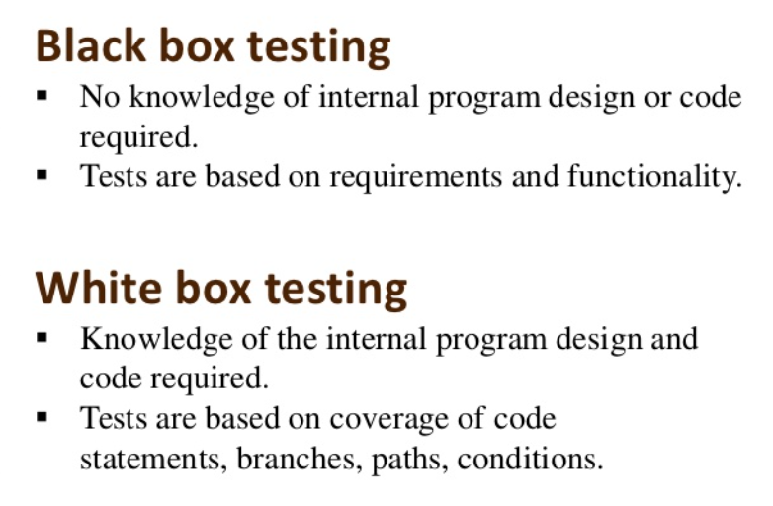

Slide 49
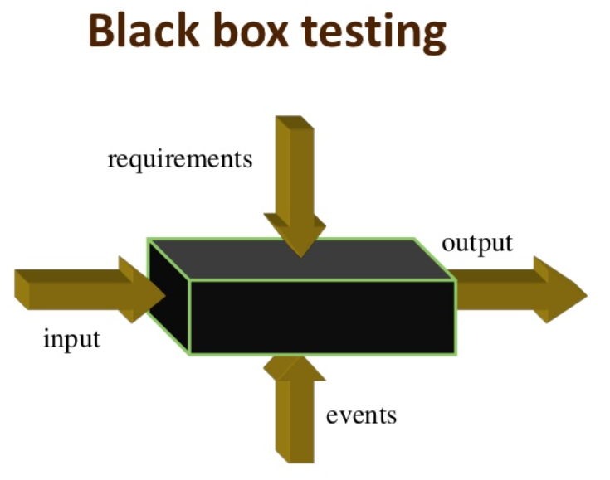
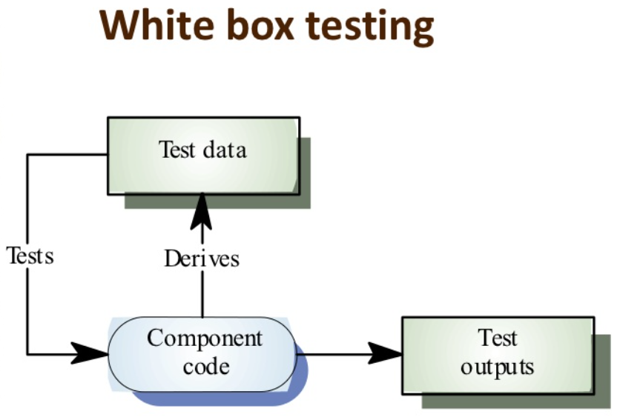

Slide 50
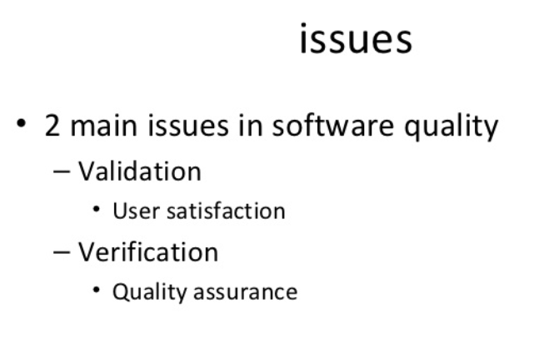
SYSTEM USABILITY & USER SATISFACTION

Slide 51
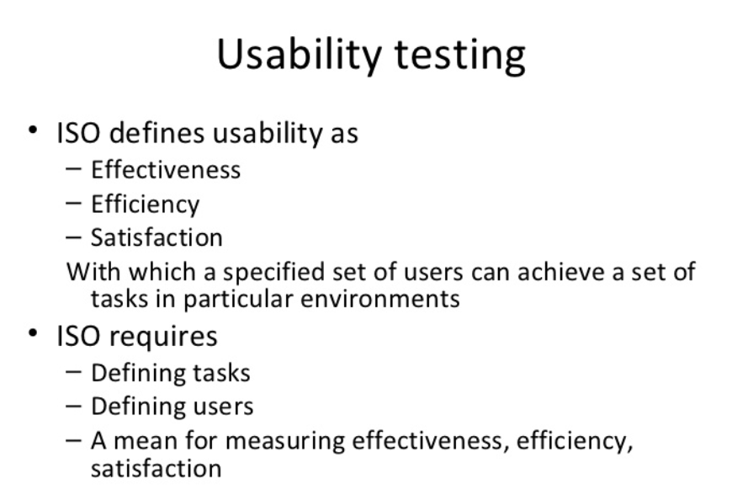

Slide 52


Slide 53


Slide 54


Slide 55


